Slide 1
HOOPS AND HURTS
Analyzing Injury Trends in Basketball

Slide 2

1. GAME PLAN.
NOTE:
To change images on this slide, select a picture and delete it. Then click the Insert Picture icon
in the placeholder to insert your own image.
This project digs into the data to reveal what puts players at risk on the court. From tracking player workloads to analyzing game intensity, we’re uncovering the hidden factors behind injuries. The goal? Equip coaches and trainers with powerful insights to outsmart injuries and keep players strong, safe, and unstoppable. 🏀💥

Slide 3
2. SCOUTING REPORT – INTRODUCTION.
This dataset is our game tape for understanding injury risks on the court. Packed with intel on Injury Type, Body Part, Severity, and Recovery Time, it breaks down exactly where and when players face their toughest hits. We’ve also got player performance stats like Hamstring to Quad Ratio, Imbalance Percentages, Distance Covered, Heart Rate, Core Temperature, and Max Jump Height giving us the inside scoop on how player’s bodies handle the grind. Sourced from in-depth session data, this is our playbook for spotting injury patterns and building a smarter, safer strategy to keep players at the top of their game.

Slide 4
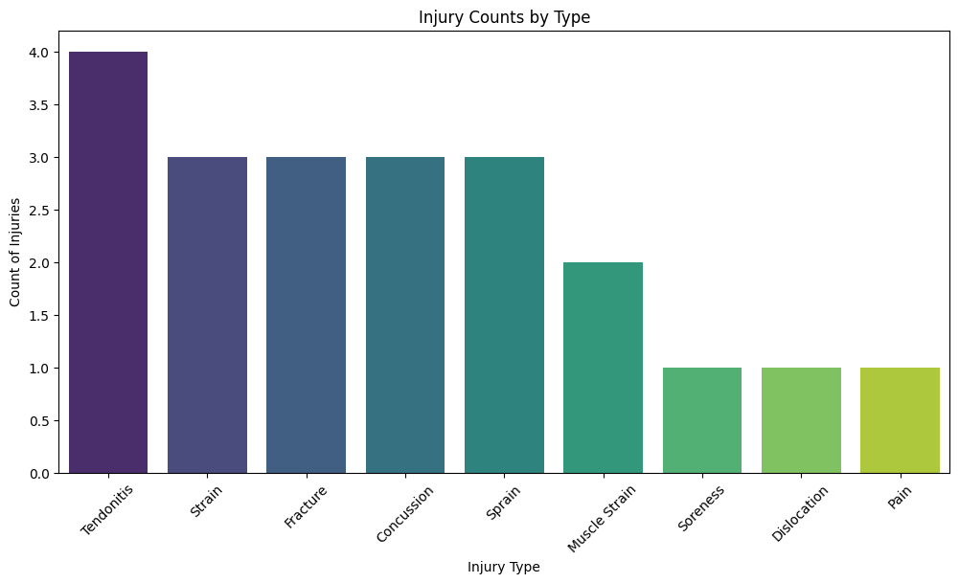
3. INJURY TIMEOUT.
This chart highlights the most common injuries on the court, with tendonitis leading the pack, likely due to the intense, repetitive movements in basketball. Strains, fractures, and concussions also rank high, reflecting the physical toll from sprinting, jumping, and contact during play. Sprains and muscle strains are frequent from quick pivots and directional changes, while soreness and dislocations show up as milder but persistent issues. These insights point to the need for targeted conditioning and recovery protocols to reduce injury risks and keep players game-ready.

Slide 5
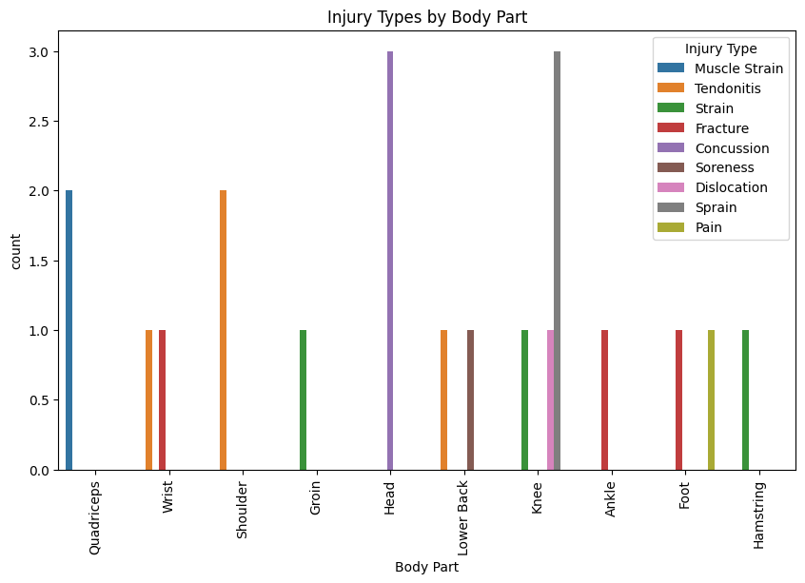
4. COURT FACTORS.
This chart shows that head injuries (mainly concussions) are a big risk, likely from hard falls and collisions. Quad and shoulder strains are common from constant movement, while knee sprains reflect the impact of jumping and cutting. Wrist and foot injuries hint at the toll from floor impact. To keep players safe, focusing on conditioning and protection for high-risk areas like the head, quads, shoulders, and knees is key.

Slide 6
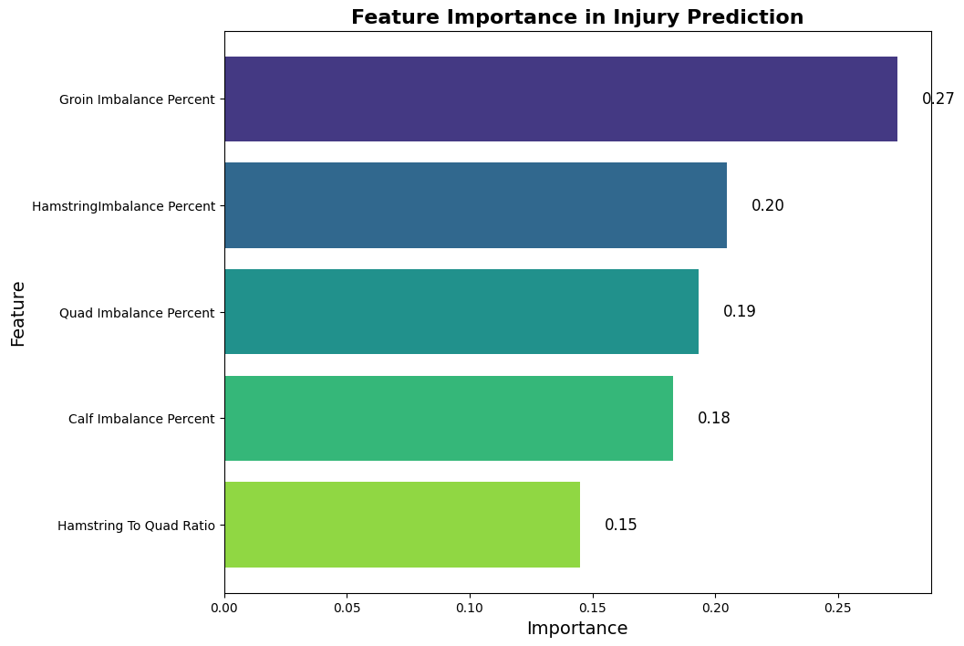
4.1 DIRECT IMPACT
This chart highlights that groin imbalance is the strongest predictor of injury, likely due to lateral movements in basketball. Hamstring and quad imbalances are also key, emphasizing the need for balanced leg strength to handle jumps and sprints. Calf imbalance and hamstring-to-quad ratio further indicate that muscle balance is essential to prevent injury, especially for explosive movements and knee stability. Prioritizing muscle conditioning and balance can help keep players on the court longer.

Slide 7
5. GAME READY OR BENCHED?
Coach, here’s the game plan with our injury prediction model:
Data & History: We’re using each player’s muscle stats and injury history to get a real-time risk profile.
Injury Probability: The model calculates how likely a player is to get injured if they hit the court.
Play or Bench: With a set risk threshold, if they’re below it, they’re cleared to play. If they’re over, we’d say “hold back” to keep them safe.
Clear Call: The model gives a solid recommendation—“Game Ready” or “Bench”—based on each player’s risk.
This is our playbook for smart, safe game-time decisions.

Slide 8
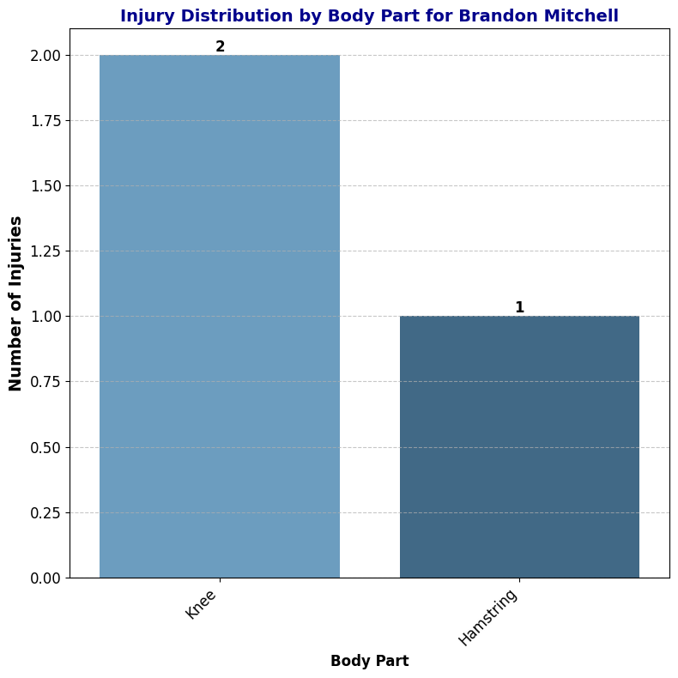
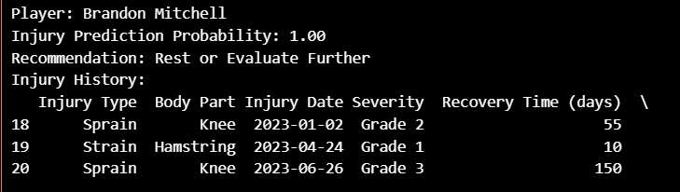
THE FINAL BUZZER.
Coach, here’s the scoop on Brandon Mitchell:
He’s got a 100% injury risk, so we’re recommending rest or more evaluation.
Injury Rundown:
Knee Issues: Two big sprains—a 55-day Grade 2 and a 150-day Grade 3. His knee stability is a concern, affecting his ability to play safely.
Hamstring Strain: A minor Grade 1 strain, but it’s still a sign of muscle strain.
Bottom line: Brandon needs more recovery time, especially for his knee. Rushing him back could lead to long-term issues. Strengthening his knee and hamstring will help get him game-ready and reduce future risks.

